Slide 1
Portal Research
Portal Menus

Slide 2
Index
Portal Reference
Nexon EU
Portal & Web Site Samples
Turkish Web Sites
Other Web Sites

Slide 3
Portal Menu Research
Portal Reference
Nexon EU

Slide 4
Portal Web Site Reference
Nexon EU : (Link)
Reasons:
Simple
Easy
Clear
Comprehensible
Useful

Slide 5
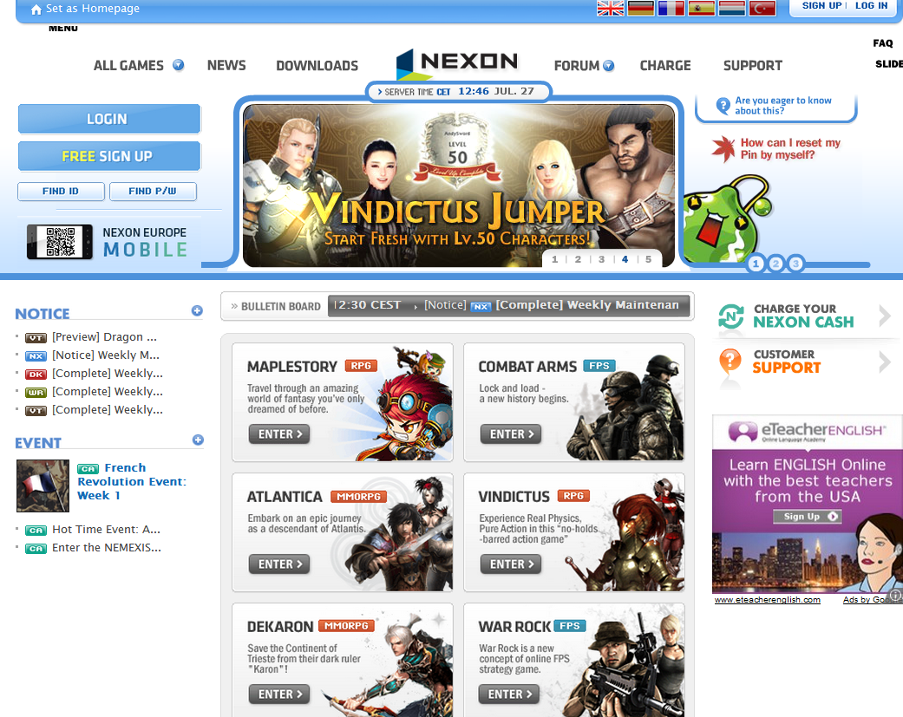
Nexon EU Web Site

Slide 6
Portal Menu Research
Portal & Web Site Samples
Turkish Web Sites

Slide 7
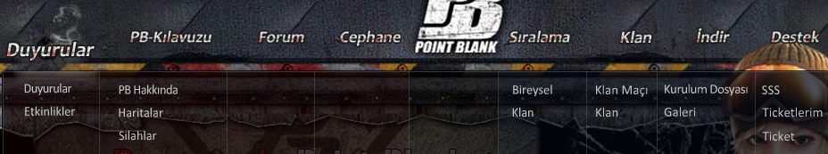
Turkish Web Sites
Main Page
About Us
News
Games
Forum
Videos
Profile
CS
Game Cash
News
As you could see, PBTR web site is giving importance to News first.
But JoyGame always gives importance to «JoyGame» reputation.

Slide 8
Portal Menu Research
Portal & Web Site Samples
Other Publishers

Slide 9
Other Publishers
Joymax
Gameforge
Nexon EU
JoyMax has the News section almost at last one. This is so bad for community.
GameForge is using my suggestion. That makes users feel that «You are important than our games»
Nexon EU Still using «Rolling Banner» Notices. Thats why they put the Games section on Portal Menu first.

